Slide 1
Evaluator of HIV-RT Personnel Competency: Overview of Certification Program

Slide 2

Learning Objectives
Describe the context, purpose, and importance of the establishment of national HIV-RT personnel certification program
Discuss certification process flow
Explain tester certification requirements

Slide 3
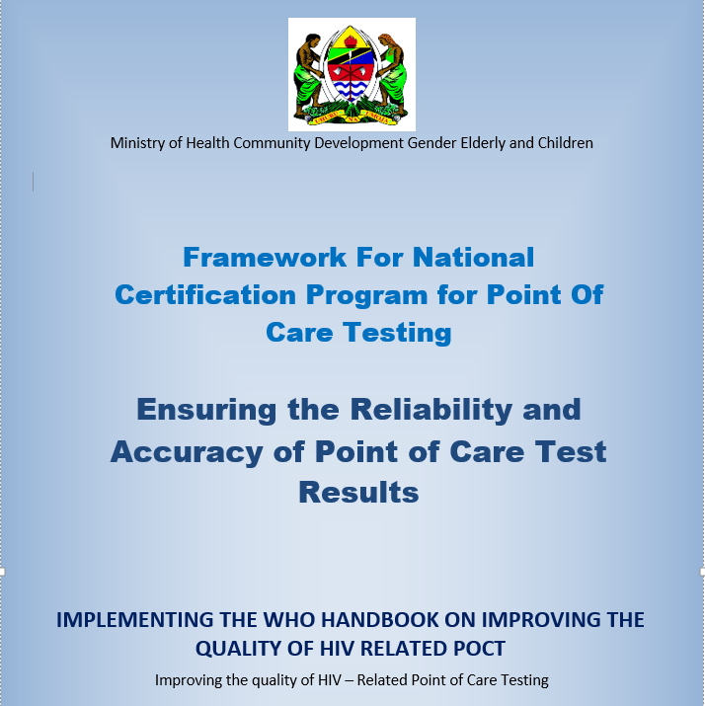
Context

Slide 4


Benefits of Tester Certification
Certification of HIV-RT Personnel:
assures others in the health care setting that they are communicating with a professional who can deliver the quality of testing services their patients need and will enhance patient safety efforts at the testing site
enhances the credibility and recognition by other healthcare professionals and the public
promotes agreement within the profession on the standards for entry-level competency
cultivates sense of personal achievement

Slide 5
Purpose of Tester Certification Program
Demonstrate Initial & Continued Competency of Testing Personnel
Certify & Re-Certify Testing Personnel
Perform Accurate & Reliable Testing Results
Ensure Accurate & Reliable Diagnosis & Treatment

Slide 6


Overview of National HIV Certification Program
National Certification Program (MOH)
Site certification program
Tester certification program
Site Audit Tools
● SPT-RT checklist
(Paper & Tablet-ODK Collect)
Site Data Management Tool
● ODK Aggregate
Competency Data Management Tool
Excel spreadsheet
Tester Certification Dashboard
Competency Assessment Tools
● Written exam package
● Practical exam package
Certification Dashboard
Site Module
Personnel Module

Slide 7
Tester Personnel Training and Certification Process
National certification
Refresher Training
Initial Training
or
National HIV RT Training Package
(MOH, IPs)
Formal 1-2 day refresher training
Mentoring/coaching
Site supportive supervision visit
Project ECHO
Targeted training
Online RT-CQI training program
Refresher training video
Competency assessment tools
MOH tools
CDC/CLSI package

Slide 8

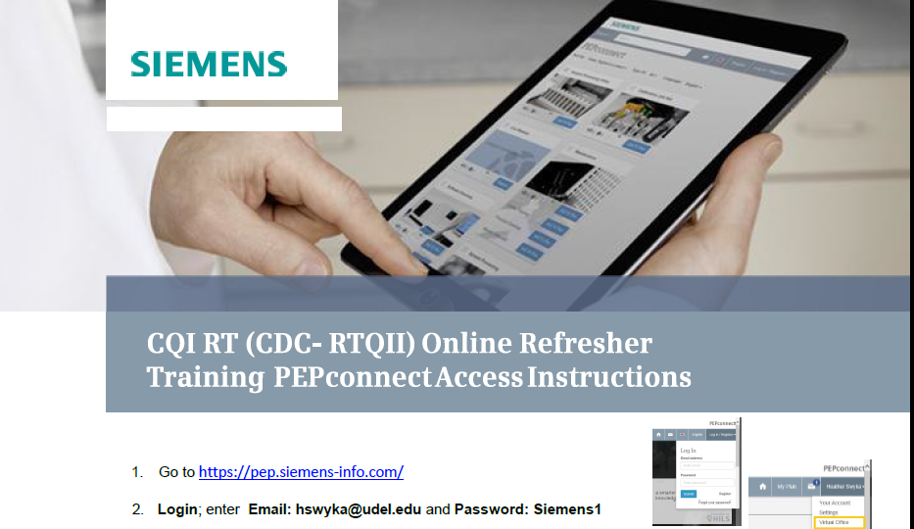
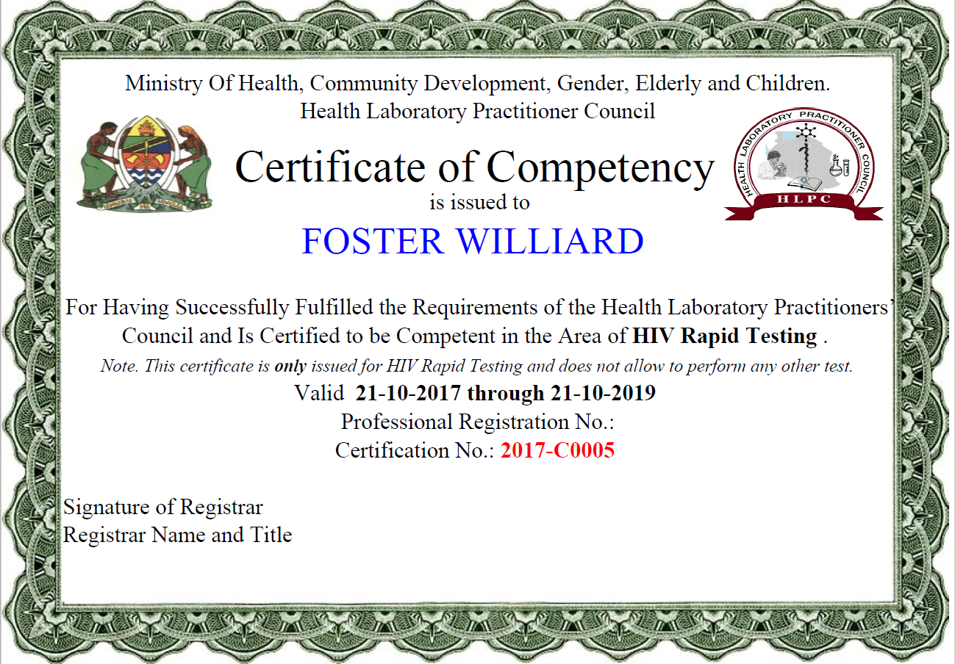

National Tester Personnel Certification Process Flow (Example 1)
Paper-based
Covers 9 testing areas
Written Exam
or
Entry of competency results in central database using Excel or Dashboard
(District/Region)
Registration of tester
(District or Region)
Personnel Certification Program
online competency
Direct observation of PT panel or client testing
+
Documentation score
Practical exam

Slide 9
National Tester Personnel Certification Process Flow (Example 2)
Written Exam
Practical exam
Paper-based
Entry of competency results in central database using Excel or Dashboard
(District/Region)
Registration of tester
(District or Region)
Personnel Certification Program
OR
online competency
Covers 9 testing areas
Direct observation of PT panel or client testing
+
Documentation score

Slide 10
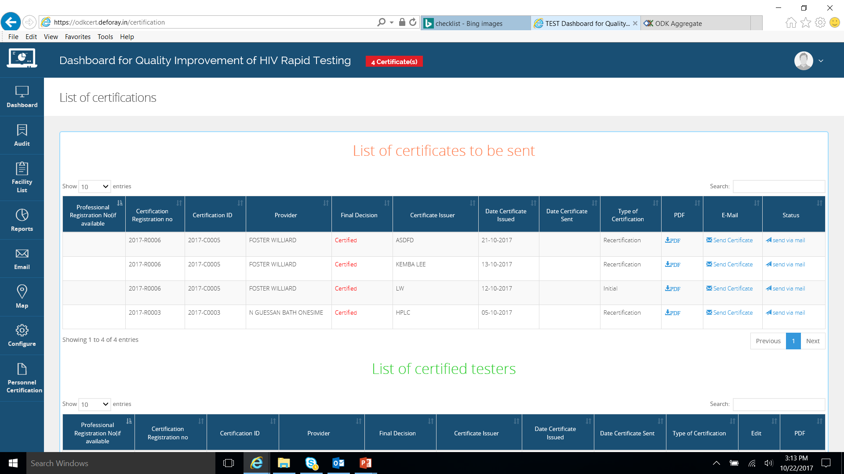

National Tester Personnel Certification Process Flow
4. Competency results transmitted for final decision
(District /Region)
1. Registration of tester (District or Region)
5. Data review and Certificate generation (certifying body)
3. Entry of competency results in Excel database or Dashboard
(District /Region)
Registering and conducting competency exams
(District /Region)
Written Exam
2. Competency exams
(Managed by certifying body)
Practical exam

Slide 11
Tester Certification Requirements
Examination Type | Passing Score
 | Initial Certification | Recertification
Written | 80% | 80%
Practical | 100% | 100%

Slide 12
Summary
What is context, purpose, and importance of the establishment of national HIV-RT personnel certification program?
What are some key components of the process flow related to HIV-RT personnel certification?
What are the requirements for HIV-RT personnel certification?

